Slide 1
Transportation Division Data Analytics Toolkit
March 2022

Slide 2
Overview
Data Manipulation
Excel
Python
R
Spatial Data Manipulation
ArcGIS
QGIS
Interactive Chart
Tableau
Plotly
Interactive Map
AGOL
Carto
MapBox GL
Database
MS SQL Server
SQLite / SpatiaLite
PostgreSQL / PostGIS
DBeaver
Other Tools
GitHub
GeoSupport
Digital Ocean
VSC

Slide 3
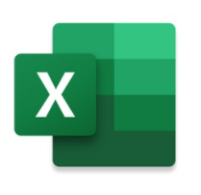
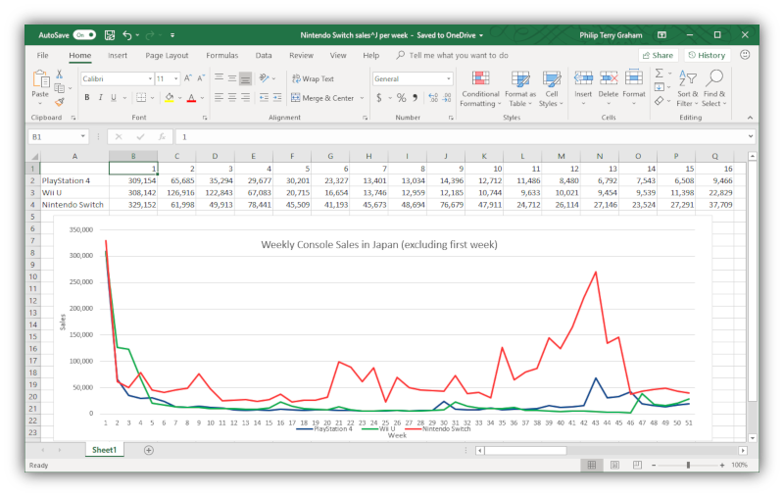
MS Excel
Creating, reading, writing, manipulating, analyzing, and visualizing relatively small datasets
Formulas (SUM, IF, VLOOKUP, etc.)
Pivot table
Static chart / map
Data Analysis Tools
Macros with VBA

Slide 4




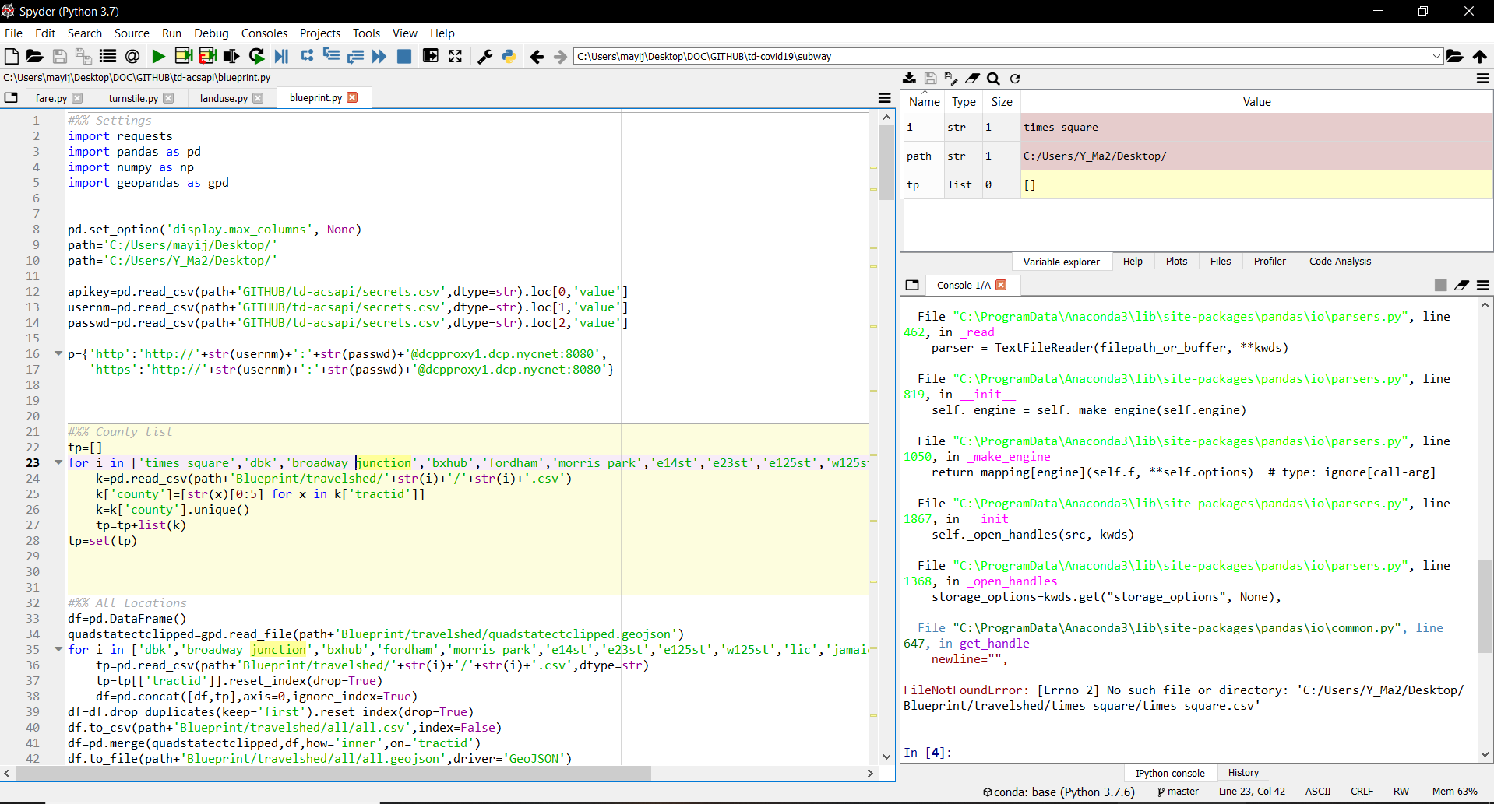
Python
Reading, writing, manipulating, analyzing, and visualizing relatively big data (general–purpose language)
Reproducibility and transparency
IDE: Spyder / Jupyter
Data wrangling: Pandas
Spatial data: GeoPandas
Interactive visualization: Plotly
Dashboard / App: Streamlit / Dash

Slide 5


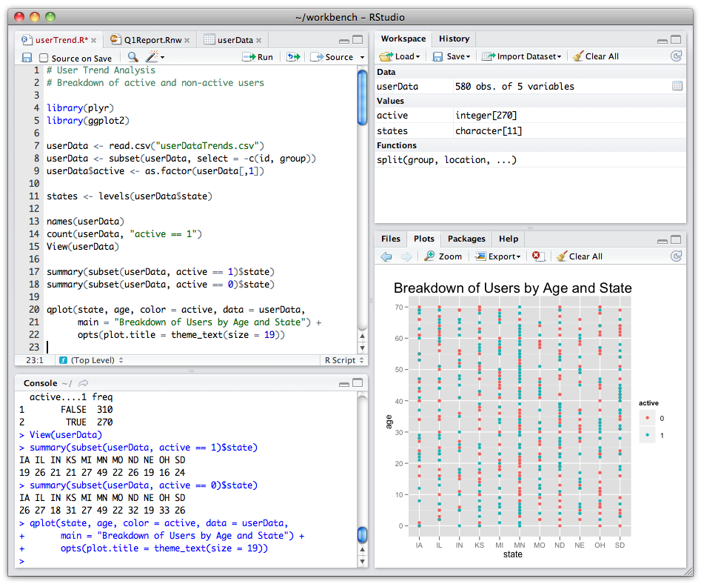
R
Reading, writing, manipulating, analyzing, and visualizing relatively big data (optimized for statisticians)
IDE: RStudio
Data wrangling: tidyverse (dplyr)
Spatial data: sf
Interactive visualization: Plotly
Dashboard / App: R Markdown / R Shiny

Slide 6


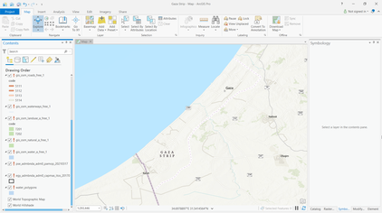
ArcGIS Desktop
Proprietary GIS software by ESRI
Creating, reading, writing, manipulating, analyzing, and visualizing spatial data
Data format: Shapefile, Geodatabase, etc.
ArcGIS Pro replacing ArcMap

Slide 7

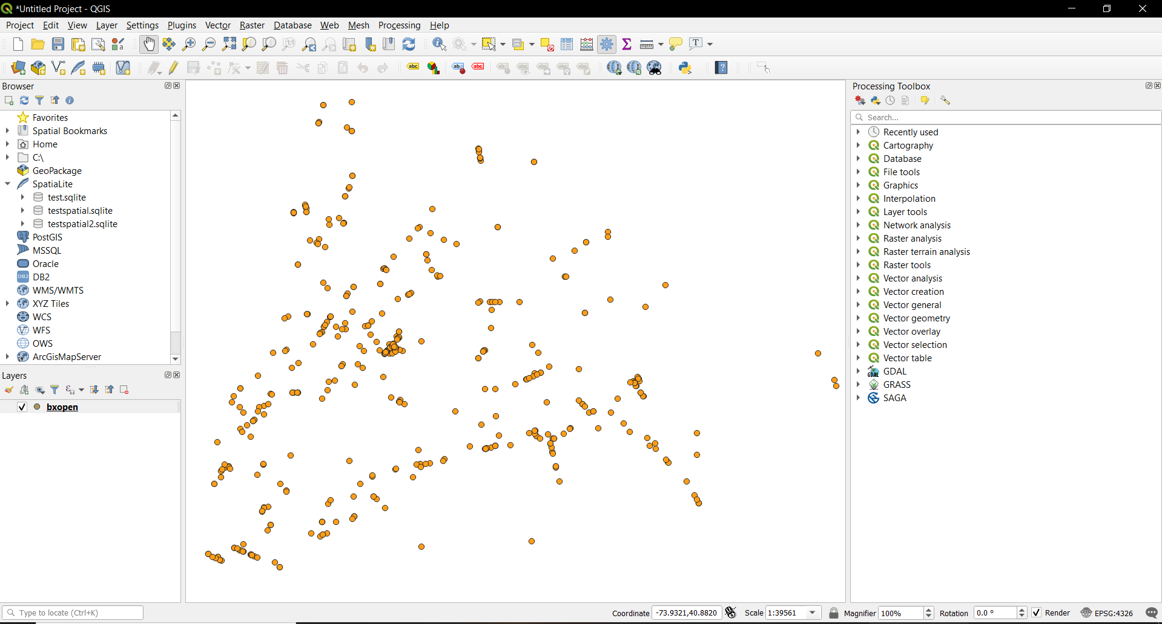
QGIS
Open-source GIS software
Creating, reading, writing, manipulating, analyzing, and visualizing spatial data
Data format: Shapefile, GeoJSON, etc.
Toolbox and plugins for geoprocessing

Slide 8


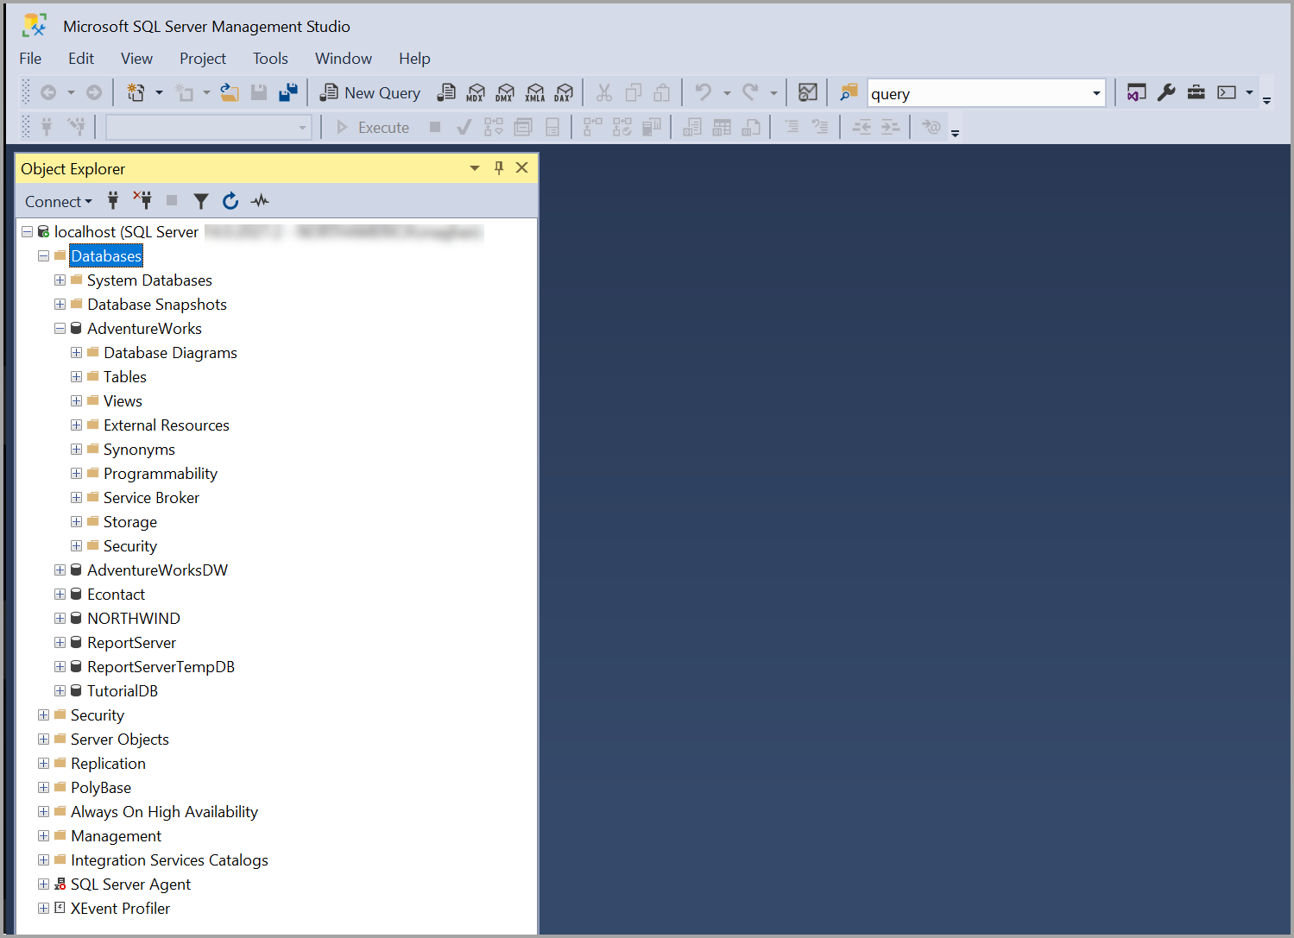
MS SQL Server
Commercial client/server relational database management system
Managed by ITD
Storing confidential datasets (TLC data)
Interface: SQL Server Management Studio / DBeaver

Slide 9
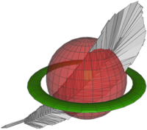

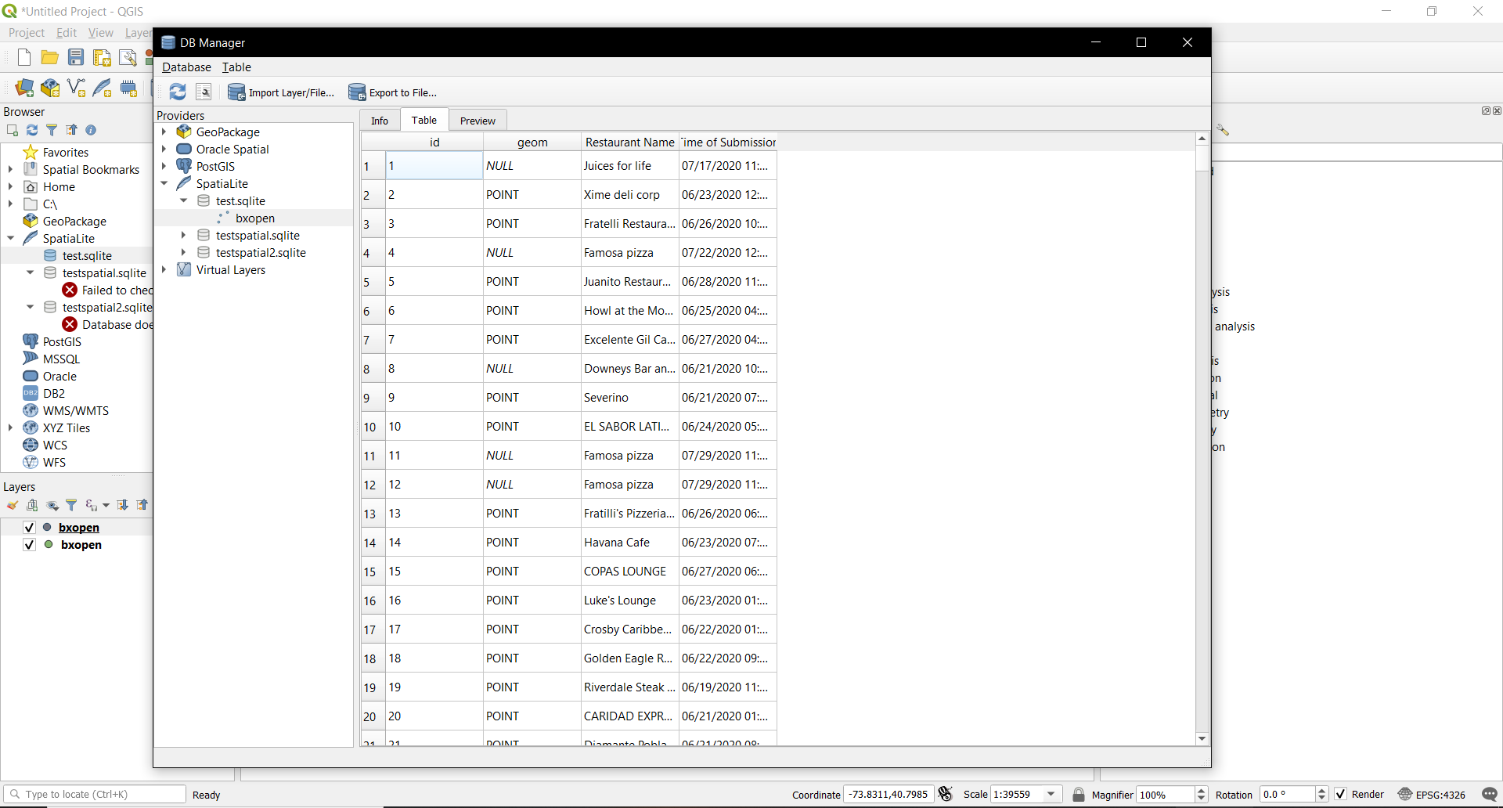
SQLite / SpatiaLite
SQLite: open-source file-based relational database management system
SpatiaLite: spatial extension to SQLite
Storing large public datasets into single database
Interface: DBeaver / QGIS

Slide 10


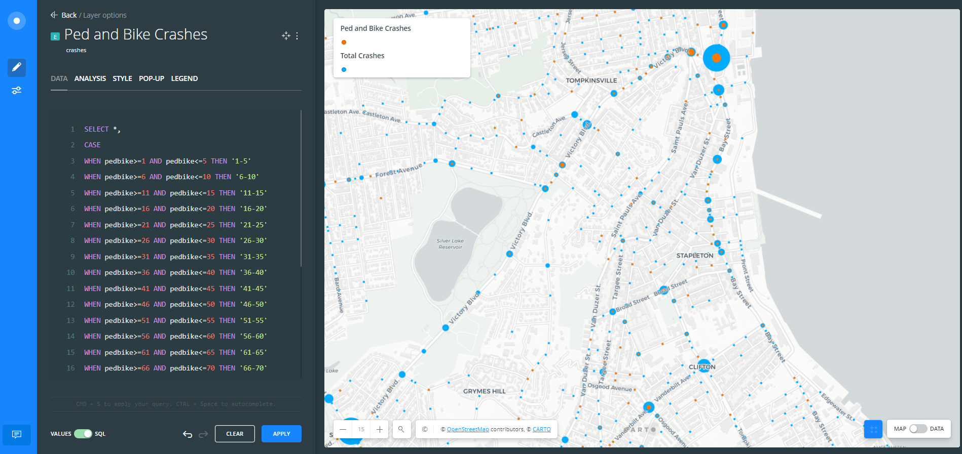
PostgreSQL / PostGIS
PostgreSQL: open-source client/server relational database management system
PostGIS: spatial extension to PostgreSQL
Storing spatial datasets
Interface: Carto

Slide 11

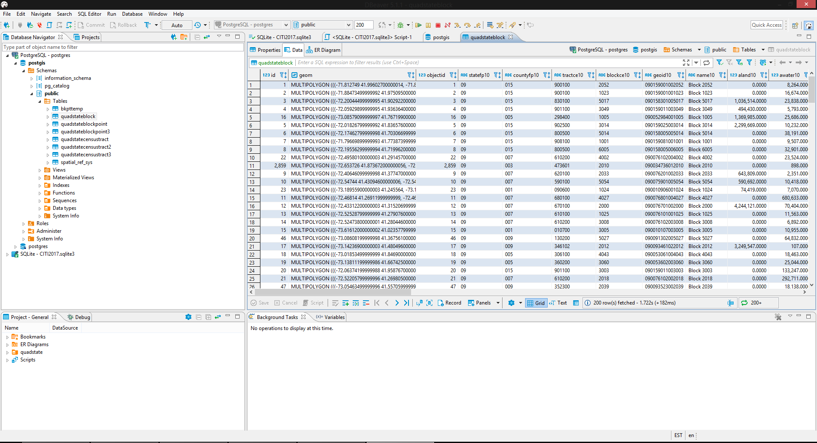
DBeaver
Database administration tool
Supports CSV, MS SQL Server, SQLite, PostgreSQL, MySQL, Oracle, IBM DB2, MS Access, etc.

